Slide 1



Working together for older LGBTIQ+
Pink50+ Netherlands
Meija Bosma & Manon Linschoten
Pink 50+ Netherlands
Notes:
Introduction of ourselves. Meija zegt:
This is Manon Linschoten, projectmanager Pink 50+. With her roots in the social work, for example within the rehabilitation sector and geriatric care, her experience in volunteer work for COC and having her coming-out at the age of 18, her start in 2008 as a project manager for Pink 50+ with COC goes without saying.
Manon over Meija: She is educated in International Management support and Financial, secretarial and administrative assistance, She has been working independently since 2011 for several (private and public) companies and for the City of Amsterdam. Since 2011 she has been working regularly for Pink50+, taking care of financial, organizational and administrative matters.
ML: Pink50+ is a non profit cooperation, a partnership of ANBO the largest elderly representative organisation in The Netherlands and COC , the oldest and largest organisation for all LGBTI, founded in 1946)
ANBO and COC has been working together since 2006. Pink 50+ is the mouthpiece for all 400000 LGBTI seniors in the Netherlands

Slide 2
100 Pink 50+ ambassadors
Notes:
Manon
Pink50+ has been looking after the interests of LGBTI seniors, aiming to improve the living conditions, health and well being of LGBTI seniors in the Netherlands in the field of care, social care and well-being.
The field of LGBTI seniors was a pretty unexplored area, as only 10 years ago little to nothing was done for the emancipation and acceptation of LGBTI seniors.
Besides our professionals, Pink50+ is depending heavily on volunteers. We have a network of 100 volunteers, mostly seniors working for us.
Here are some of them. The Pink 50+ ambassadors are the most important asset of our organization.
They have diverse tasks:
- local and regional lobby at care institutions, government and so on,
being visible as LGBTI seniors, Pride activities
Organise and facilitate of local group meetings in the country.
empowerment of the target group, the ambassadors en their network
Every ambassador does one’s part in his or her own way, knowledge and competence.

Slide 3
100 Pink 50+ ambassadors
Notes:
Meija:
We work inside out and outside in.
Meaning: the ambassadors set the targets, tell us what is needed and what issues are important at the moment.
We facilitate and train the ambassadors, we guide them along the way and they report back to us.
It’s all about raising awareness, visibility and empowerment of LGBTI seniors. Almost all of our ambassadors are part of the target group LGBTI seniors

Slide 4
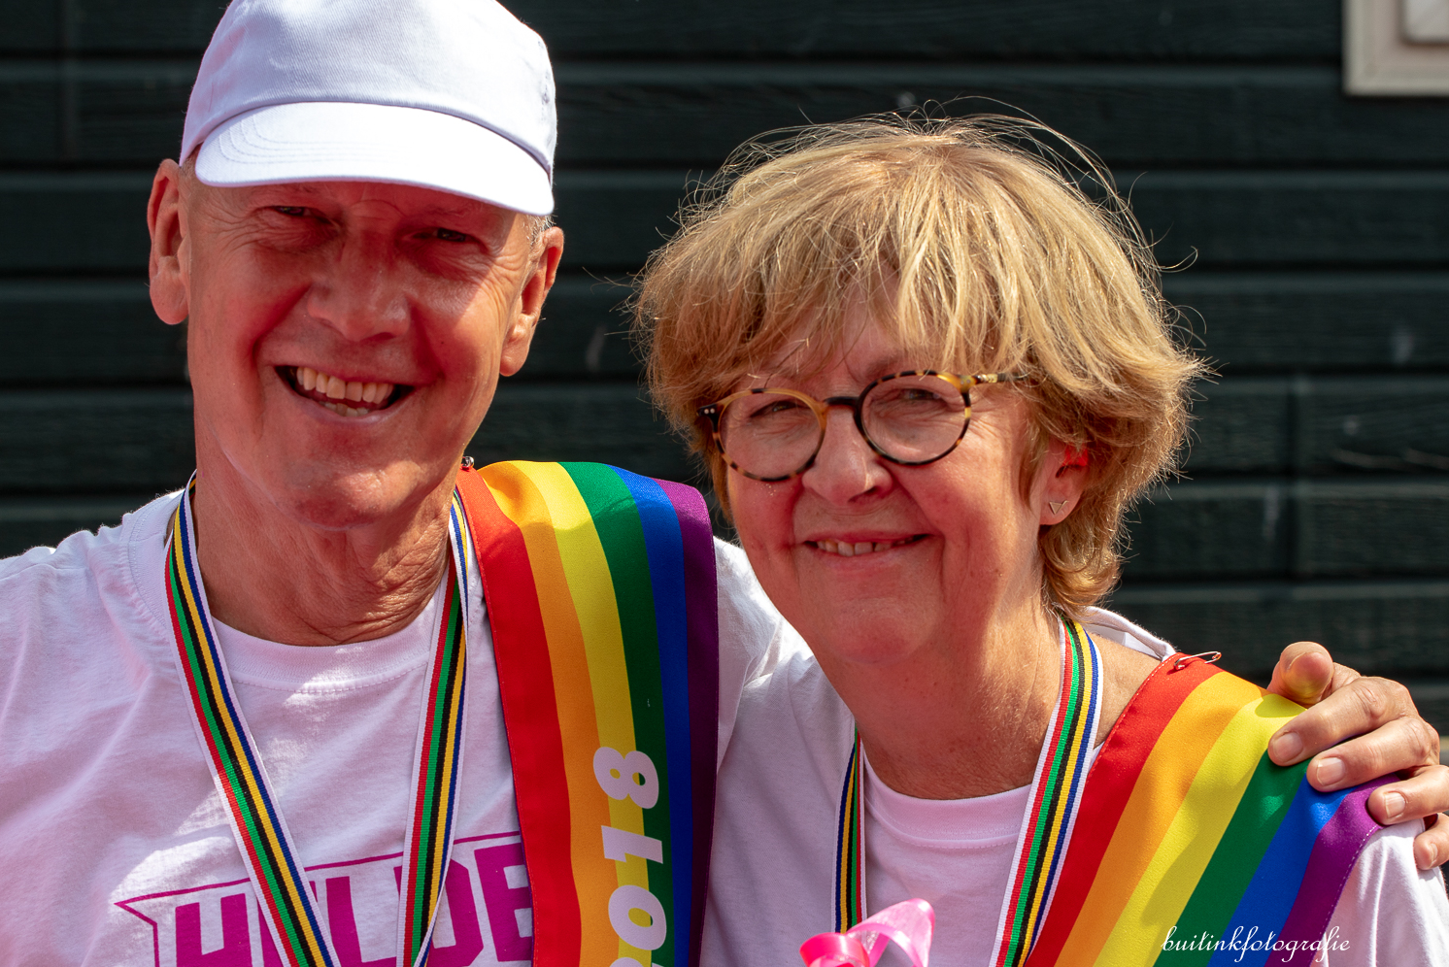
100 Pink 50+ ambassadors
Notes:
Manon
Mr en Mrs Senior Pride 2018
Every year we have a contest for a Mr and Mrs Senior Pride. From the nominations we choose the Mr and Mrs.
Both of them are Pink 50+ ambassadors.
Kees is from Utrecht and a retired policy officer of the city of Utrecht.
Ditty is a retired doctor in Zeeland. She is a straight woman, and very much involved in the work for LGBTI seniors

Slide 5
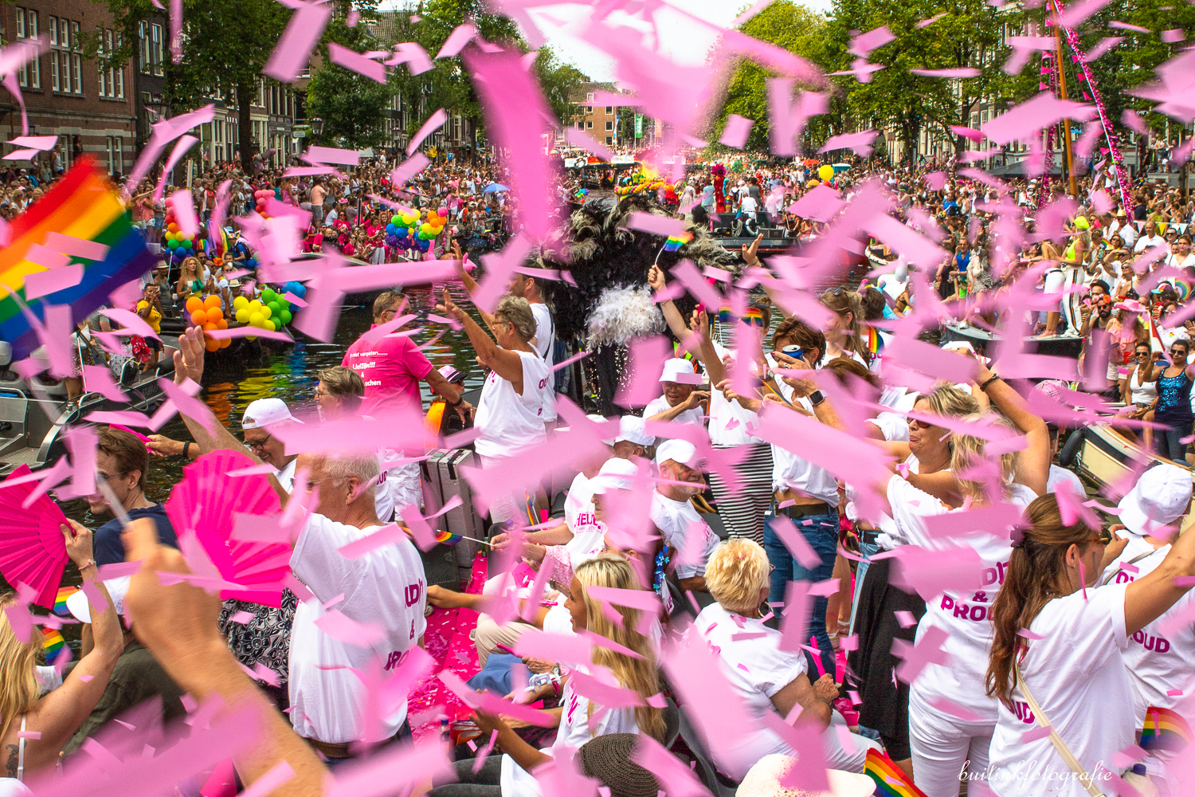
100 Pink 50+ ambassadors
Notes:
Manon
Every year the city of Amsterdam organizes the Gay Pride, for visibility, awareness and simply just having fun together.
Pink 75+ boot
Together with some of the Pink Passkey residential care organisations, Pink 50+ organizes this year for the tenth time a boat on the Gay Pride in Amsterdam, for the clients of the care organisations. People who live in the care facilities in Amsterdam, most of them being over 80 and their doctors and nurses, join us on this boat at Pride.
These people are our heroes, people who have fought for our rights and made it possible that we can be who we are.

Slide 6
LGBTI seniors are at risk
Go back into the closet
Small social network
Hardly any care by family, friends or neighbors
Living in loneliness and isolation
Notes:
Meija:
Seniors are vulnerable, even more if they are LGBTI. Letter volledig noemen
They deserve to live the last part of their life just being them selves
Especially LGBTI seniors often lack a social network, having for example no children, and not seldom being abandoned by their family and friends after coming out of the closet.
This leads to isolation and loneliness

Slide 7


Animation film made by Latte Creative
Notes:
Meija
Silver rainbow campagne ILGA 2015
on Long term care, let older LGBTI people enjoy long term care with dignity. This video explains te reason why we started the intervention Pink Passkey
https://vimeo.com/album/3577987/video/140197882

Slide 8

The Past
Notes:
Manon
It was COC Nijmegen, one of the members of COC Netherlands that initiated the first Pink Passkey back in 2008.
The Pink Passkey is a official certification for LGBTI friendliness which can be obtained by care and social care facilities, after passing an independent audit
The Pink Passkey is symbolized as a key that opens every door for everybody

Slide 9
Past
2010 National development of the Pink Passkey Scan
The objective is to improve the social acceptance of sexual diversity and gender identity in care institutions
Notes:
Manon
Since 2008 then the Pink Passkey has undergone many changes during its further development.
With the addition of the Pink Passkey Scan during this process the Pink Passkey has become a quality tool enabling objective measuring within the professional care centers. This development has been made possible by the support of the Dutch Ministry of Health, Welfare and Sports.

Slide 10
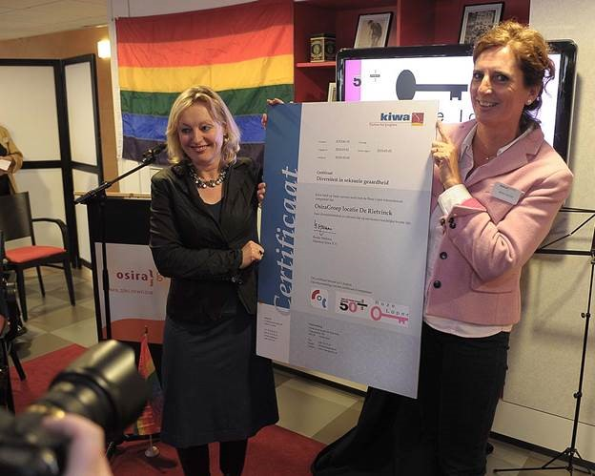
Past
Notes:
Meija:
The first national Pink Passkey was awarded in 2010 to De Rietvinck, one of the nursing homes of the Amstelring, an Amsterdam-based care center for the elderly. The Pink Passkey method has been focusing at first on elderly care such as residential care centers, nursing homes and home care organizations.
At the left you see the minster of Education and Emancipation rewarding care organization with the Pink Paskkey

Slide 11

Our vision:
promoting awareness on the differences between people,
changing the course within the organisation structure and
holding on to this change in policy and activities,
proper care and attention for LGBTI seniors.
Notes:
Manon
The Pink Passkey aims to enlarge knowledge and awareness for sexual diversity and gender identity.
Our vision is: promoting awareness on the differences between people, changing the course within the organisation structure and holding on to this change in policy and activities. In this way proper care and attention can be given to LGBTI seniors .
This is a vulnerable group which – in view of its history – deserves openness, respect and safe old days.
One of the key success factors of the Pink Passkey are the Pink 50+ ambassadors. They reach out to and persuade organisations to get started with attention for sexual diversity and gender identity. Beyond they advise and coach the organization.
Pink 50+ ambassadors work to increase knowledge and awareness for sexual diversity of management, employees and residents. This increases the acceptance and understanding. By this approach it more often goes without saying that there is a safe atmosphere and the diversity of all people is taken into account.

Slide 12
Present
Client stories
Notes:
Manon
We did research and found out that the people living in Pink Passkey organisations are generally positive, proud and satisfied. In particular LGBTI residents explicitly express feelings of safety, acceptance, tolerance, visibility, mutual solidarity and without discrimination. Other residents who have experienced exclusion, misunderstanding or discrimination benefit from the Pink Passkey approach, because the conversation about diversity is conducted more frequently, so they also feel more accepted. LGBTI residents claim that the success factor of the Pink Passkey is visibility.
They experience the climate in a Pink Passkey-care institution as LGBTI friendly.

Slide 13
Pink Passkey
Stimulates awareness among management and staff of healthcare institutions.
respect and openness
ensuring privacy
attention and training in dealing with sexual diversity and gender identity
Notes:
Meija
Stimulates awareness among management and staff of healthcare institutions.
respect and openness
ensuring privacy
attention and training in dealing with sexual diversity and gender identity
For the Pink Passkey certification Pink 50+ cooperate with 6 certifying institutions

Slide 14

The Toolkit Pink 50+ is a collection of interventions, concrete instruments that arouse discussions and boosts visibility of LGBTI seniors.
Notes:
Meija
The toolkit Pink 50+ is a collection of tools consisting of interventions arouse discussions or boosts the visibility of pink elderly. It involves tangible activities and instruments for LGBTI friendly culture, care, treatment, and policy support.
The toolkit includes:
Advice and support with coaching calls
Training for professionals and volunteers
Information meeting for residents and their family and friends
Travelling photo exhibition
Story telling
Suggestions for documentary’s, films
Interactive theatre
Various Singing and performance options

Slide 15

Developments:
Going Abroad
Care for handicapped people
Social Care organisations
Working with more independant Certifying institutes
Notes:
Manon
Nowadays more than 160 centers for elderly care and social care institutes have been awarded with the Pink Passkey. There is also a German version, based on the Dutch original, awarded to the Frankfurter Verband in Germany.
Now it also targets the care for LGBTI’s with handicaps as well as social care institutions and LGBTI friendliness in hospitals.
Therefor we adapted the PP scan in a general guideline towards social acceptance.
Working with more CI’s makes it easier for the care organisations working with this quality system to be able to include sexual diversity in there organizations

Slide 16

Future
Notes:
Manon
We do a lot of projects nationally and are want to raise a voice for LGBTI seniors internationally.
Attention for LGBTI seniors reaches beyond its goal. It leads to more attention for someones uniqueness, lifestyle, history and culture.
Join us at the conference 26th of April, Focus on LGBTIQ+ seniors!
Thank you for your attention

